Slide 1
PHONICS SCREENING CHECK
1. WHAT IS THE PHONICS SCREENING CHECK?
2. WHEN IS THE PHONICS SCREENING CHECK?
3. WHAT DOES IT LOOKS LIKE?
3. KEY INFORMATION
4. RESOURCES TO HELP YOUR CHILD

Slide 2
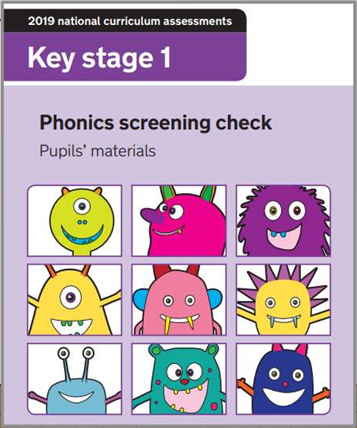
WHAT IS THE PHONICS SCREENING CHECK?
The government introduced this check to allow teachers to assess children’s developing phonic knowledge. It is a test administered to Year 1 children nationally.
It is an assessment where children are given 40 words to read correctly to the teacher. It is 1:1 assessment that they do in a quiet environment.
In this test, children will recognise and identify sounds that individual letters and combinations of letter make, and blend these sounds together from left to right to make a word.
This is to ensure that can children can use this knowledge to segment and blend new words that they hear or see as they get older.
Children need to read 32 or more words correctly to pass the Phonics Screening Check. This has been the standard score required in the previous checks, but it could be subject to change every year.
It is not a timed activity.

Slide 3
WHEN IS IT?
The Phonics Screening Check for 2025 will begin the week of Monday, June 9th, 2025.
They will complete the test 1:1 out of class with me.

Slide 4
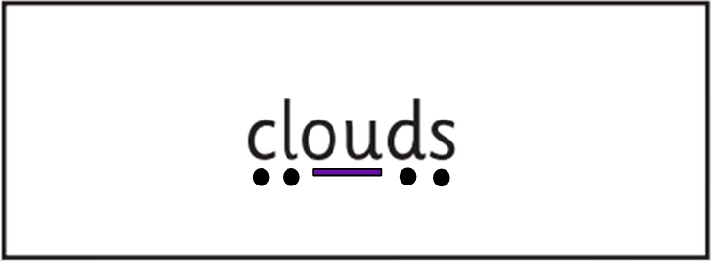
WHAT IS THE PHONICS SCREENING CHECK?
In this example, children should be able to identify the individual phonemes that
make up the words by;
Looking at the word first to identify any known graphemes.
Segmenting the word into individual sounds out loud.
Blending the individual sounds to form a word.
Then checking the word to see if it makes sense.
Example of segmenting and blending.
Example taken from the 2022 Phonics Screening Check, page 19.
At this point in the year, children have been taught all the split-digraphs, digraphs, trigraphs and graphemes needed for the Phonics Screening Check .
Children can segment and sound-talk and blend it in their head. Children can use their finger to point to any graphemes they can spot. Some children can read words instantly.

Slide 5
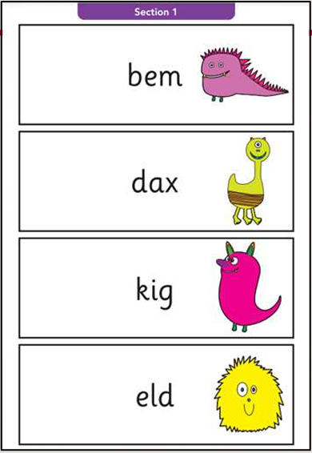
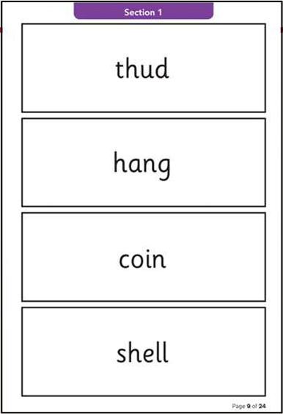

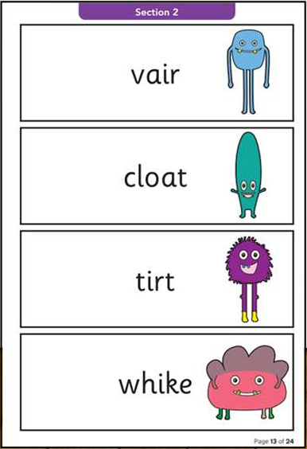
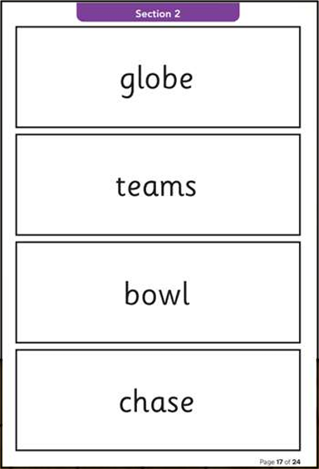
WHAT DOES IT LOOK LIKE?
Section 1
To a child
12 ‘nonsense’ words.
8 real words.
Single letters (a, b, c, d, e, f, g, h, I, j, k, l, m, n, o, p, q(u), r, s, t, u, v, w, x, y, z)
Some consonant digraphs (ch, ck, ff, ll, ng, sh, ss, th, zz)
Frequent and consistent vowel digraphs (ar, ee, oi, oo, or)
Section 2
8 ‘nonsense’ words.
12 real words.
Less frequent and consistent vowel digraphs, including split digraphs (a-e, ai, au, aw, ay, ea, e-e, er, ew, i-e, ie, ir, oa, o-e, ou, ow, oy, ue, u-e, ur)
Trigraphs (air, igh).

Slide 6
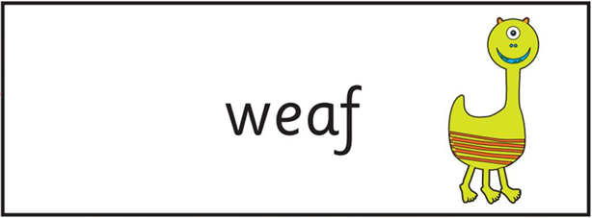
Nonsense Words
All ‘nonsense’ words will be accompanied by a picture of an imaginary creature. This is so it let's the children know it is not a real word and so, the children know not to turn the word into a real word. (e.g. meat, meats, yeast, east)
These words are included in the check specifically, to assess whether you child can decode a word using phonic skills and not their memory. They need to be able to read and decode words that are unfamiliar to them.
When children experience new words for the first time in their reading books, they have to use their decoding and blending skills to identify the word through their known phonics knowledge. The Phonics Screening Check checks to see if they can do this with good accuracy.
In some examples of the nonsense words, digraphs can have alternative pronunciations. With this word, children may get the mark for either answer;
weaf or weaf
This is only in the case of a few words!

Slide 7

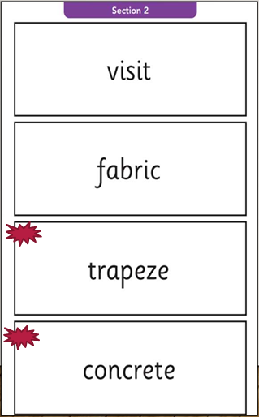
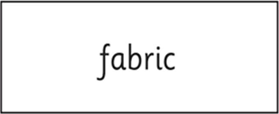
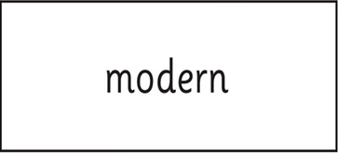
Challenging Words
Section 2 is generally where children lose the most marks. It is a section that contains complex words, words containing split digraphs and digraphs that are generally harder to learn or are unusual.
Example taken from the 2022 Phonics Screening Check, page 21.
There will be some words that have multiple phonemes in the word and may overwhelm a child. Children can use their fingers and hands to help segment the word and break the word into easier sections, specifically identifying phonemes that they can see in the word.
Some words may have split digraphs. (See examples to the left).
Some words may look like they have a split digraph. Children may see a split digraph and segment and blend the word and if it doesn’t make sense, children can attempt to try and blend it again.
The assessor is unable to tell the child if they are right or wrong. The assessor cannot help them.
“mode– ern” (That is not a real word)
“m-o-d-er-n” (That is a real word)

Slide 8
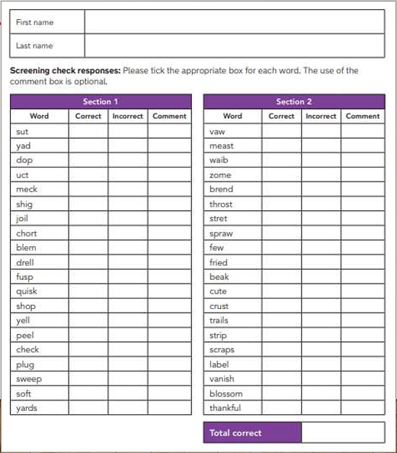
MORE INFORMATION.
Example of a score sheet that the assessor uses.
The pass mark for the past 6 years has been 32/40.
The PSC should identify children who have not learned to decode using phonics by the end of Year 1, if they have not got the pass mark or above.
These children will then receive additional support in Year 2 to ensure they can improve their decoding skills. They will retake the PSC in Year 2.

Slide 9
RESOURCES TO HELP YOUR CHILD
The Department for Education (DfE) also publish guidance which you can find here: https://www.gov.uk/government/publications/phonics-screening-check-information-for-parents
Alphablocks - lots of videos and games to help with recognising letters and reading.
www.bbc.co.uk/cbeebies/shows/alphablocks
​Phonics Games - A variety of different interactive games
www.ictgames.com/mobilePage/forestPhonics/index.html​
BBC Bitesize - this game allows your child to listen to the sounds in a word and to pick the correct letter. Then they can see what word they have made with all of the sounds together. www.bbc.co.uk/bitesize/topics/zyfkng8/articles/zt27y4j
Phonics play - there are several free games to play that will help your child with their blending and segmenting.
www.phonicsplay.co.uk/Phase3Menu.htm
​

Slide 10
PAST PAPERS
2019 Phonics Screening Check
2022 Phonics Screening Check
2023 Phonics Screening Check
2024 Phonics Screening Check
More Phonics Screening Practice
Phonics Screening Practice Paper 1
Phonics Screening Practice Paper 2
Phonics Screening Practice Paper 3
Phonics Screening Mock Test 1
Phonics Screening Mock Test 2
Phonics Screening Mock Test 3

