Slide 1


Welcome to Tadnoll Class
2025 / 2026
Teacher: Mel Williams
Teaching Assistants: Mrs Lee, Mrs Bevis & Mrs Aldridge
Year Group: Reception and Year One

Slide 2
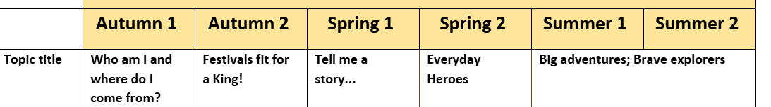
The Year Ahead…
Information about school trips, any visitors and additional events will follow nearer the time.

Slide 3
Statutory Assessments
Reception Baseline
Year One Phonics Check
Teachers will assess pupils in all year groups at regular intervals throughout the year and your child’s progress will be shared with you in parent teacher consultations (usually October and February) and in the final annual written report (July).

Slide 4
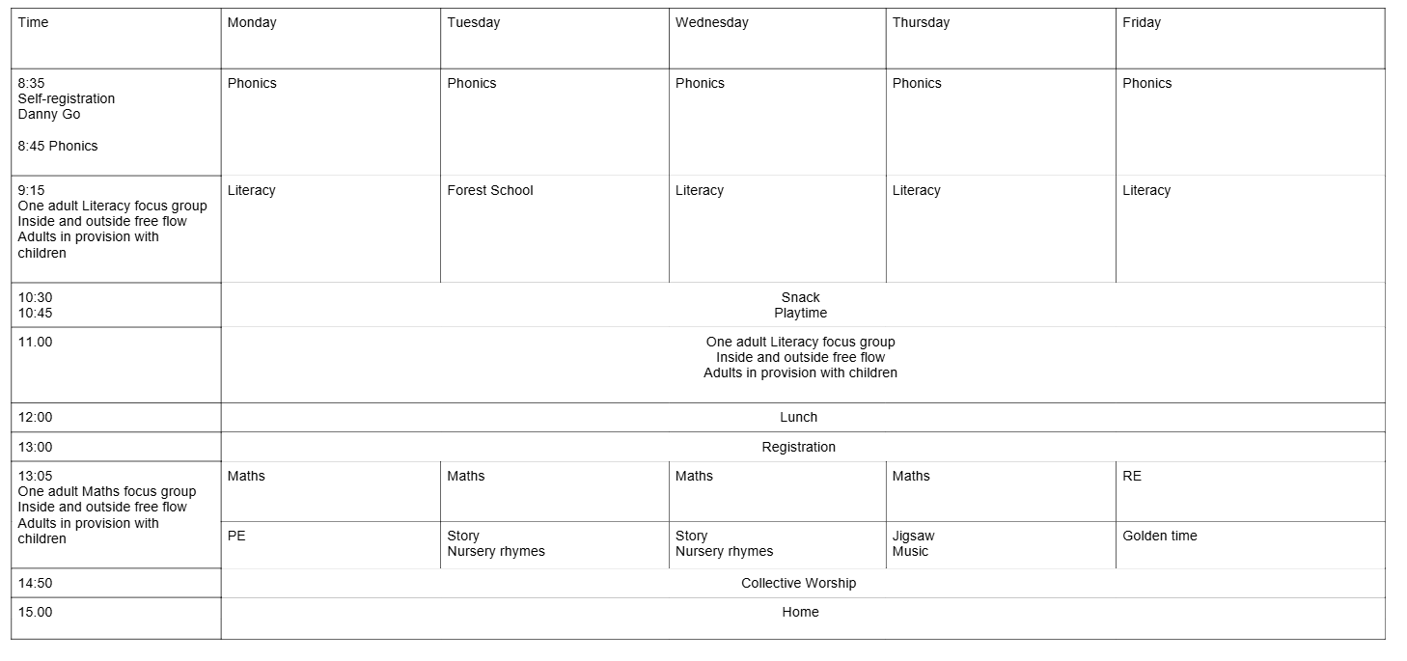
Weekly Timetable
PE on Mondays - Forest School on Tuesdays

Slide 5
Uniform
Our uniform is supplied by AF Joy, a clothing shop in Wareham. They have a full selection of items in stock and are open 6 days a week.
Please ensure ALL uniform and book-bags are clearly named.
Uniform:
Burgundy cardigan or sweatshirt with logo
White blouse, shirt or polo shirt
Dark grey skirt or trousers or tailored shorts
Red and white checked dress for summer
Black shoes which can be polished (no trainers)
PE kit:
Burgundy shorts
Plain dark grey/navy/black joggers
Yellow T Shirt with logo
Burgundy sweatshirt/hooded top or burgundy school fleece with logo
Trainers
For health and safety reasons we do not allow children to wear jewellery. The exceptions to this rule are earring
studs in pierced ears, watches and small objects of religious significance. Children are required to remove any
items during PE lessons to prevent them from causing injury. Alternatively, children can use suitable tape to
cover studs.
Hair bands, ribbons/bows or
‘scrunchies’ should be plain and should not have large decorative items attached.
Make up and nail varnish
should not be worn to school.

Slide 6
Equipment
Children should bring in a named water bottle every day. They can bring in a separate lunch drink (e.g. squash)as well if they would like to.
Children should bring in their reading book and reading record every day
EYFS and KS1 will be provided with a free fruit/vegetable snack
KS2 should bring in their own fruit/vegetable snack
Only Year 6 children are welcome to bring in an optional pencil case

Slide 7
Forest School
Forest School Day is Tuesday
Expectations for Forest School:
Wear PE kit
Bring separate wet weather puddlesuit/waterproofs and wellies/walking boots

Slide 8

Home Learning
Expectations for Reception:
Daily reading to be recorded in child’s Reading Record 6 times each week. Books are changed on Mondays, Wednesdays and Fridays. Books must be read twice before they are changed.
Expectations for Year One:
Daily reading to be recorded in child’s Reading Record 6 times each week. Books are changed on Mondays, Wednesdays and Fridays. Books must be read twice before they are changed.
Purple Mash tasks
Numbots Maths games

Slide 9

Reading at Home
Encouraging children to read for pleasure is one of the most important things that parents/carers can do to help improve life chances!
Children should be reading (and listening to books read to them) daily.
Reading record needs to be completed and signed 6 times a week.
Awards for engaging in reading at home

Slide 10

Positive Learning Behaviour
Children are awarded Trackit lights throughout the school day (both in and out of lessons).
Green Trackits are awarded for displaying our school values and positive learning behaviour.
If a child does not respond to a warning, they may receive an amber Trackit and red Trackits are then given for a significant disruptive action.
Parents/carers will be informed if staff are concerned about the learning behaviour of a child and they will work together to complete a Support Plan

Slide 11

What To Do If You Have A Concern/Question
Parent Teacher consultations will take place this half term.
A member of SLT will be stood at the doorway to greet children every morning. The Teacher will be in the classroom with the children. Messages will be passed to the teacher by the office staff or the member of SLT each morning.
At the end of the day, the teacher will hand your children to you and then will be available to speak to. This is a great time to ask questions or share information.
If you have a more specific concern or question, please email: LWPS.Office@coastalpartnership.co.uk where a member of the office team will forward your query to the teacher.
Teachers are happy to arrange lunchtime or after school phone calls and meetings if needed, at a mutually convenient time. The teacher can also meet with you after school at the Lulworth site by arrangement.

Slide 12


Any Questions?

