Slide 1


The Importance of Reading
Overview:
Reading is key
How we teach reading skills at L&W
Importance of ‘Reading for Pleasure’
How families can support
Mrs McHarg and the KS2 team
4/11/2025
Notes:
We’d like to talk to you today about the importance of reading and how we teach reading skills at our school.

Slide 2






How we teach reading at Lulworth and Winfrith:
Word Recognition (Decoding) | Comprehension
Supersonic Phonic Friends scheme to teach phonics Reception-year 2. | Banded school reading books in sets. Class texts (age appropriate). Whole class guided reading lessons to teach the year group objectives (KS2). Small group interventions, including Lexia.
Being able to decode does not mean you understand what you read.
A child can sound like a ‘good reader’ but not necessarily understand what the text means.
Notes:
At Lulworth and Winfrith, we have a structured approach to teaching reading. In the Foundation Phase, we use the Supersonic Phonics scheme. This helps our students develop their phonics knowledge and decode words accurately.
.

Slide 3
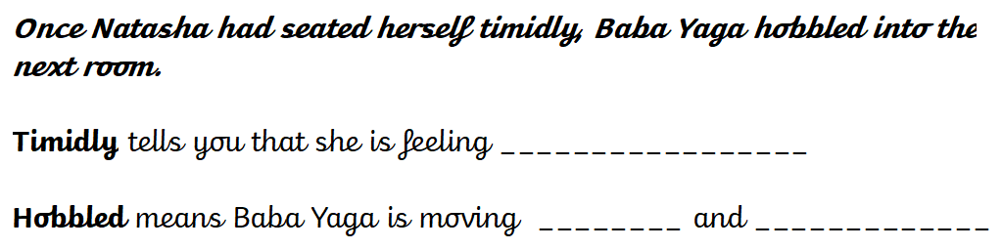
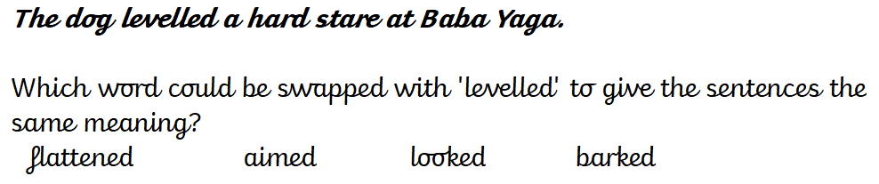
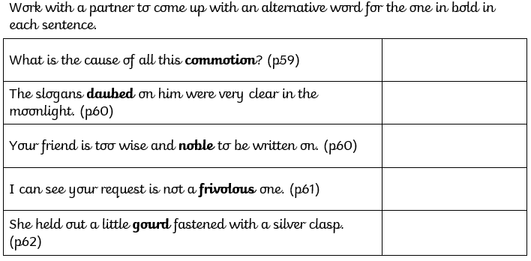

Notes:
Here are some examples of how we teach comprehension through VIPERS.

Slide 4

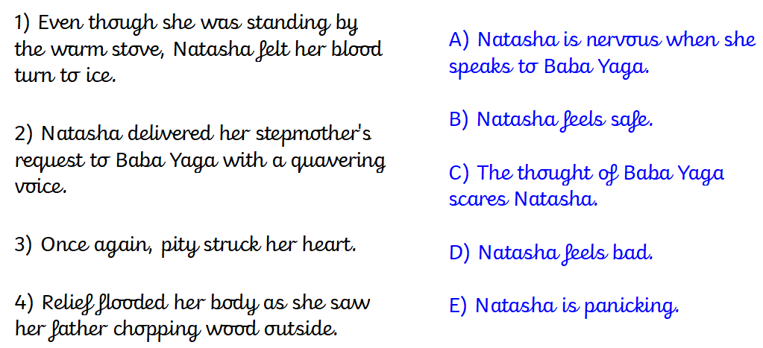
How do you think the author felt about Victorian children? What tells you this?
Inferring ideas, or guessing what the author means, is part of the joy of reading. Every time we read a book and get involved in the suspense of the plot, guessing what is going to happen next, we are using inference skills - and this is what makes reading books so fun.

Slide 5

Write a prediction about the book using the front cover as evidence.
Sentence 1 – What do you think the book will be like.?
Sentence 2 – What evidence from the front cover of the book have you used?

Slide 6
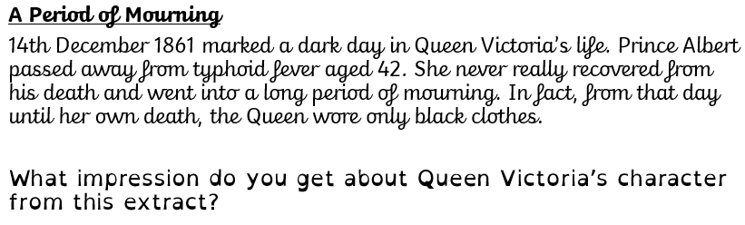
How does writer build suspense in this paragraph?
Which was the most exciting part? Why?

Slide 7
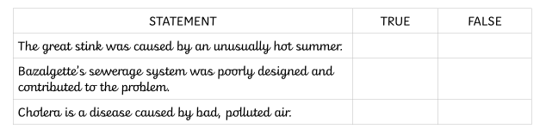
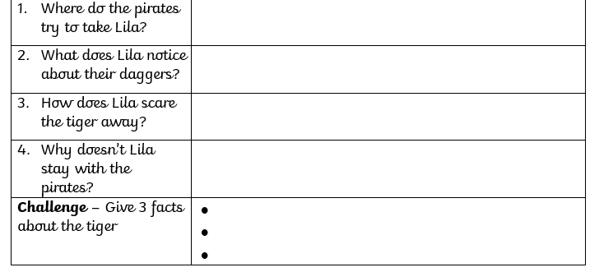
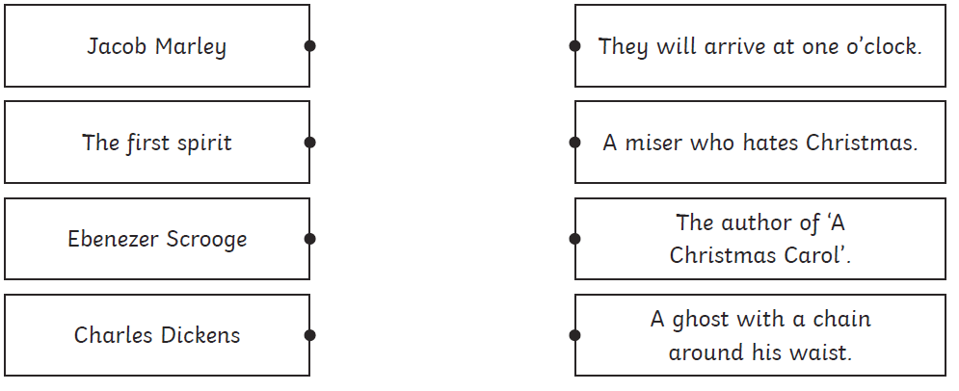
Skimming – reading quickly through an extract to take in the whole thing
e.g. On p33, who talks the most times?
Scanning – skipping through an extract to look for a particular word/phrase
e.g. Find the date Queen Victoria was born.

Slide 8
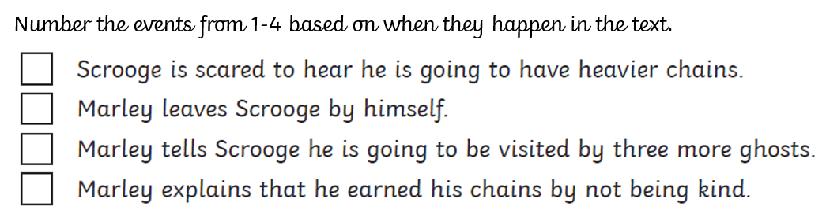
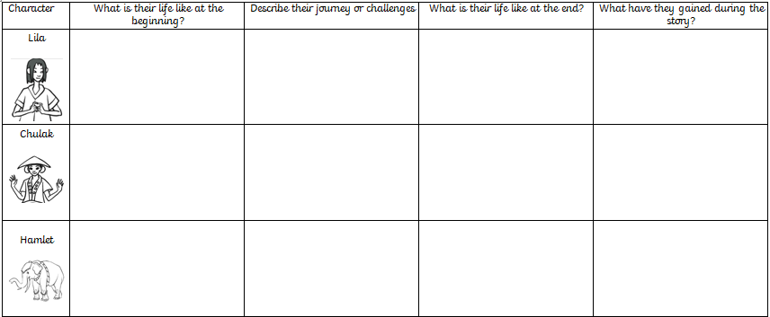
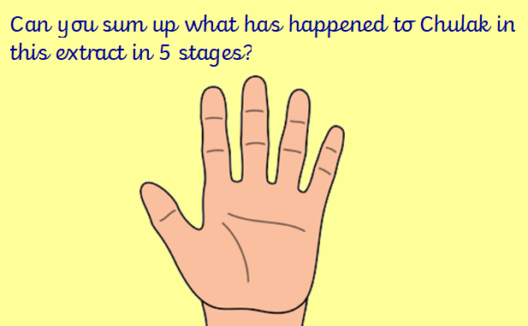

Slide 9
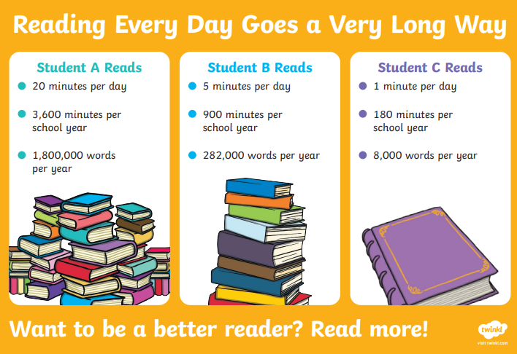
Reading is a skill. We can teach it in a classroom, but it must be practiced to become fluent.
Children will not practice reading unless it is accessible, available
and enjoyable.
Notes:
Reading is not just a skill; it's an enjoyable and enriching activity. We call it "reading for pleasure." Reading for pleasure includes escapism, engagement, empathy, enlightenment, and entertainment.
Amaris: Research shows that there is a positive relationship between reading frequency, reading enjoyment, and attainment. Let me share an interesting statistic with you. If a student reads for 20 minutes a day, they will end up reading for 3,600 minutes a year and approximately 1,800,000 words per year.
Bronte: On the other hand, if a student reads for only 5 minutes a day, they will read for about 900 minutes a year and approximately 282,000 words. And if a student reads for just 1 minute a day, they will read for 180 minutes a year and around 8,000 words.

Slide 10
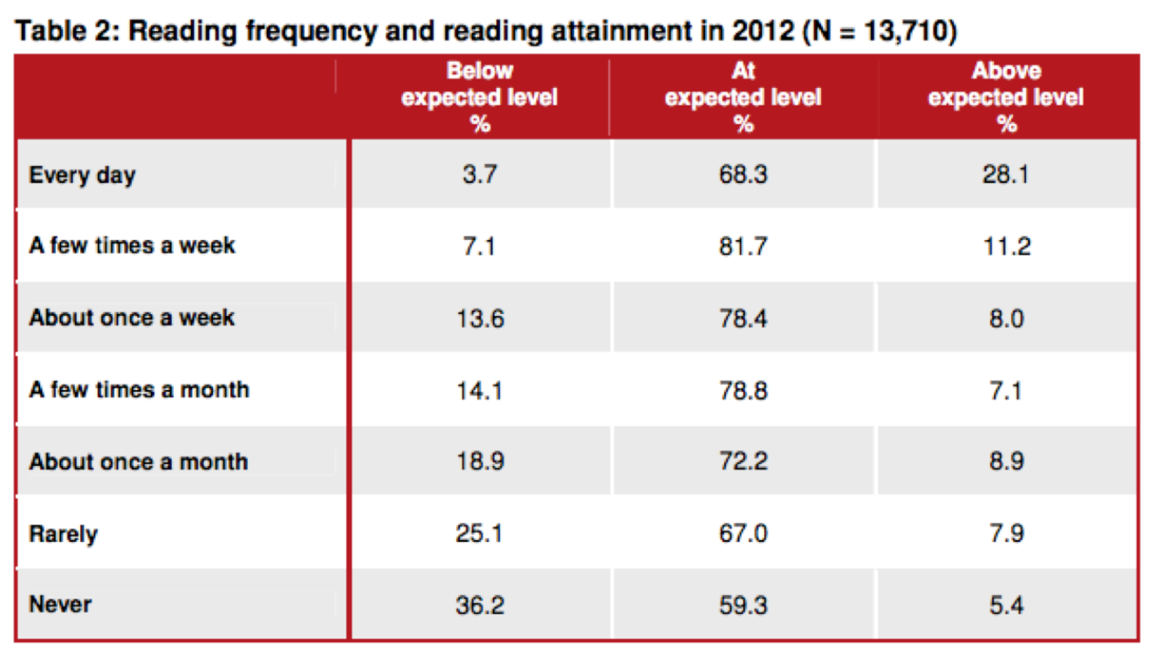
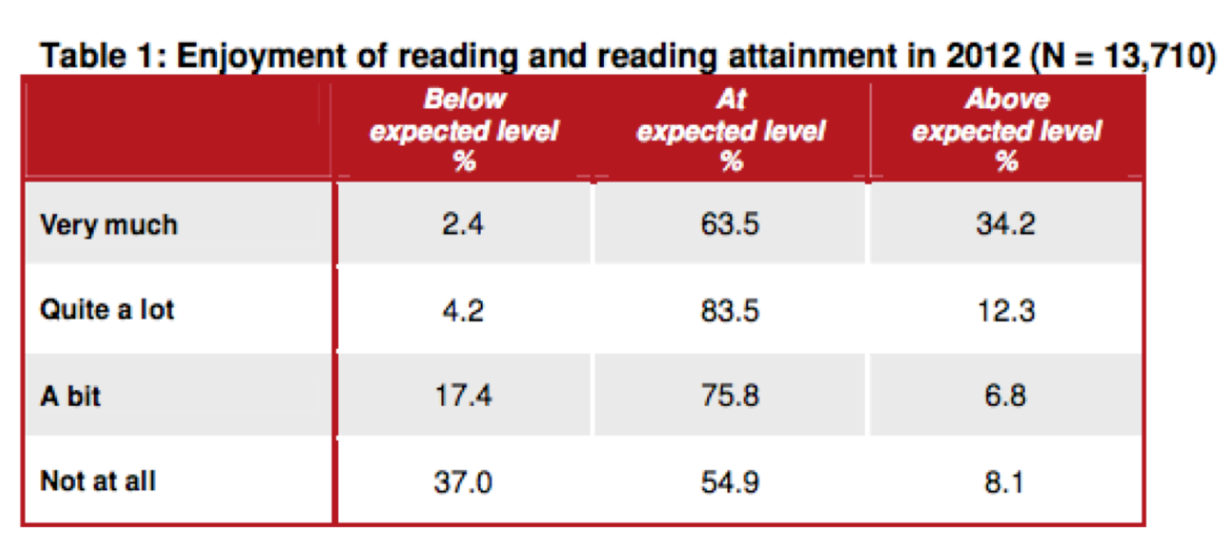
Notes:
So, you can see the tremendous impact reading for pleasure can have on a child's language development and academic success.

Slide 11
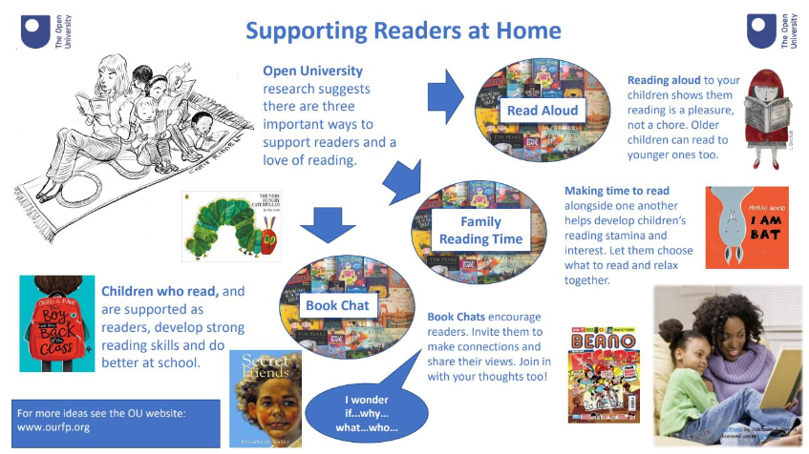
Notes:
Empowering Your Child's Reading Journey at Home. As parents and guardians, you have a significant role in supporting your child's reading development. Here are some practical tips to create an inspiring reading environment at home.

Slide 12
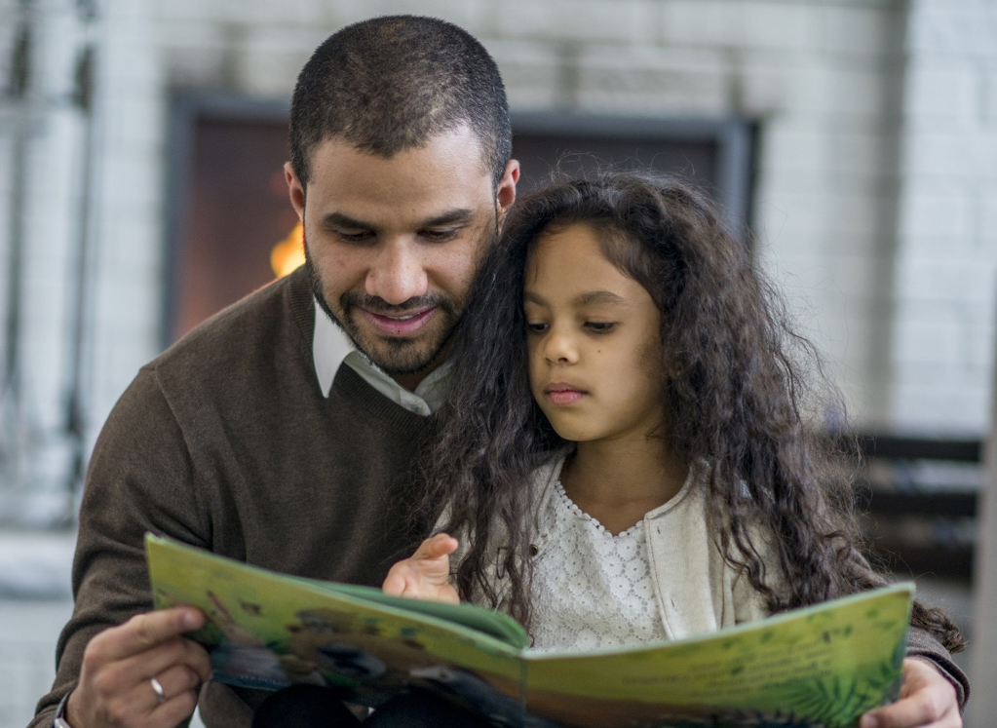
How can support your child at home:
Make reading visible; have books available in your home and let your child see you reading. Children need to see that reading is something adults do too.
Respect children’s reading choices. They may have their colour-banded book to read, but we also encourage them to read anything and everything that interests them.

Slide 13




How families can support
Visit the library and make use of free reading apps like Libby, BorrowBox, Get Epic and Sumdog.
Re-read familiar and favourite books.
Try to avoid making reading feel like a punishment or a chore.
Notes:
Respect your child's reading choices. While they may have assigned books from school, encourage them to explore their interests freely. Visiting the library and utilizing free reading apps like Get Epic, Sumdog, Libby, and Borrow Box.

Slide 14
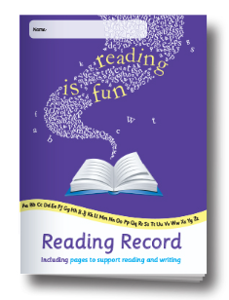
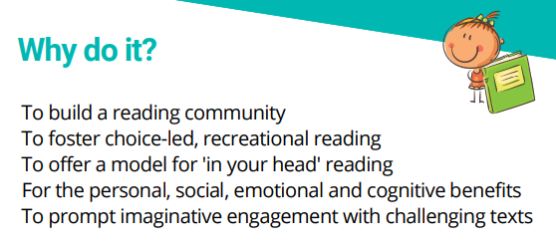
How families can support
Make time to listen to them read – even when they are fluent.
Talk to them about their reading, ask open-ended questions and make connections with their own lives and interests.
Read aloud to them.
Notes:
Remember, reading should never feel like a chore or a punishment. Engage your child by asking open-ended questions and helping them make connections to their own lives and interests. Let's cultivate a lifelong love for reading together!

Slide 15
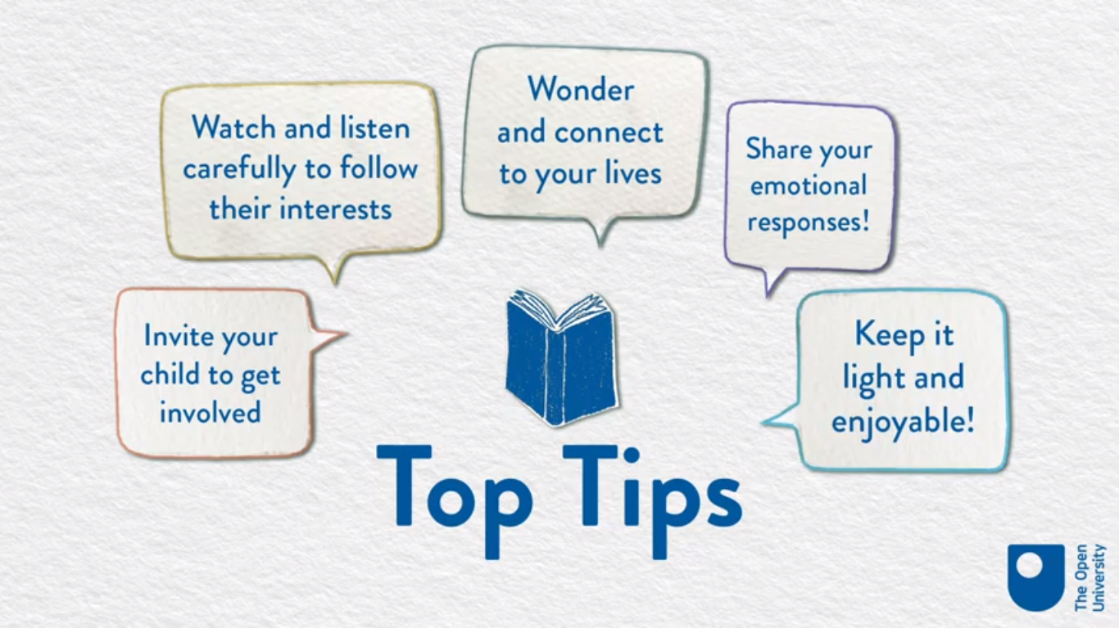
How families can support
Video
https://ourfp.org/supporting-rah/book-chat-reading-with-your-child/
Notes:
Reading is to the mind what exercise is to the body.

Slide 16
'The more that you read, the more things you will know. The more that you learn, the more places you'll go.’ – Dr Seuss

Slide 17

Guided Reading Tour
You will now have the opportunity to visit your child’s classroom to observe some guided reading activities, look in their guided reading books and celebrate their reading achievements.

